Slide 1

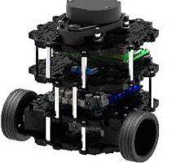
Work Algorithm
Design Control System for Robot Similar to TurtleBot
Prepared by: Majed AbdulQadir

Slide 2
Contents
1
The Aim
2
The Technique
3
How to use The Technique
4
Stages of work

Slide 3


The Aim
The Aim is to Design a control system for TurtleBot by using Arduino uno, similar to that in Rose operation system.

Slide 4
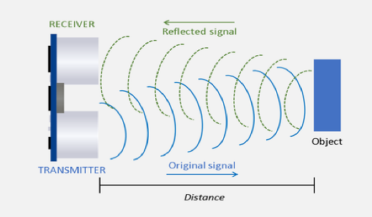
The Technique
To make the TurtleBot robot move smarter, we will use the ultrasonic sensor.
Ultrasonic Sensors measure the distance to the target by measuring the time between the emission and reception.
This will help us avoid hitting the objects

Slide 5
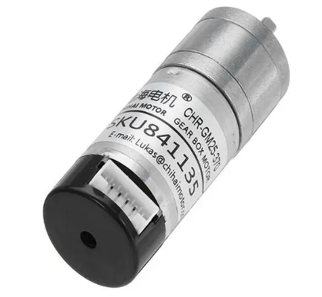

How to use The Technique
We will use DC motors with encoder to find out the number revolution per minute RPM, for that we should knowing the number of pulses per revolution PPR from Specification:
$$RPM=\frac{PPS}{PPR}∗60$$
* PPS = NO. of Pulses per second

Slide 6
Ultrasonic sensor
How to use The Technique
Read signal
Read distance
Distance >= 20
If
Distance < 20
Stop wheels
Return

Slide 7
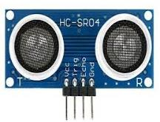

How to use The Technique
Ultrasonic sensor
Controller
Distance
DC Motors with encoder

Slide 8
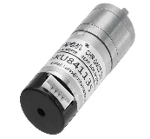
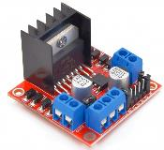

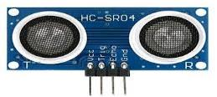
Stages of work
To start with, we should buy two DC motors with encoder and ultrasonic sensor
We will also need a transistor and a motor driver - H-Bridge
We will be programing the ultrasonic sensor and wheels with the Arduino and insert them into a loop
We place an if condition, where if the distance of ultrasonic 20 greater than , the first and second wheels will move clockwise automatically, and the RPM will be printed using the serial monitor.
Else the distance in the ultrasonic is less than 20, the first wheels will stop and move counterclockwise, while second wheel will rotate clockwise, and the RPM will be printed using the serial monitor.

Slide 9

Opinion
If you want to make the wheels go to specific distance and avoid hitting the objects
We can do it by knowing the how many pulses, will use an equation and adding it to the loop and knowing the wheel diameter and the PPR from Specification:
$$Wheel revolution= π ∗Wheel Diameter$$
$$Pulses= \frac{Distnce you want ∗PPR}{wheel Revolution}$$

